Slide 1

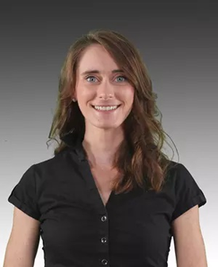
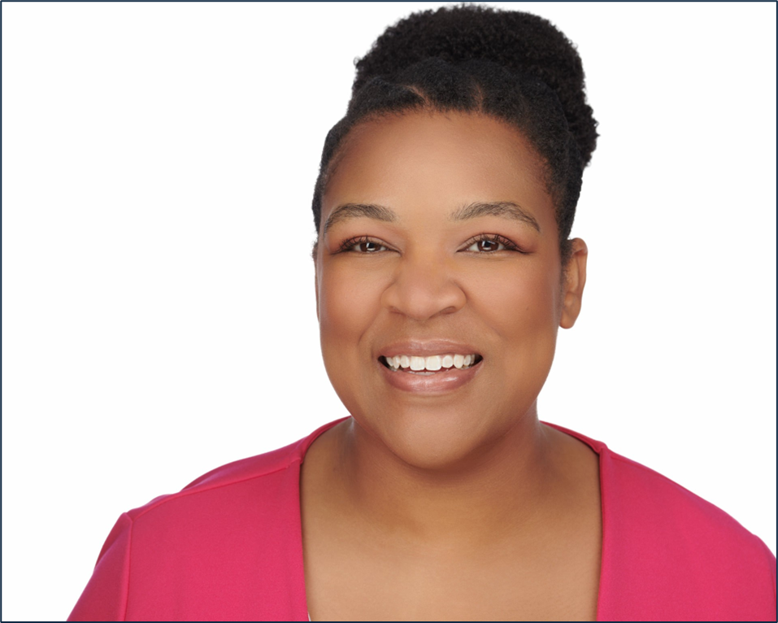
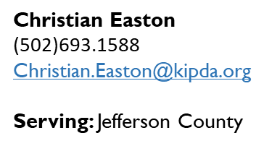


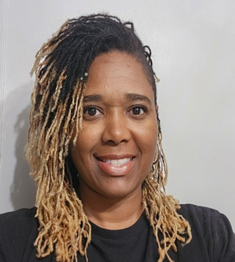
To apply for coverage online: https://kynect.ky.gov/ or call: 855.459.6328
Danielle Mack
(502)416.8807
Danielle.Mack@louisvilleky.gov
Serving: Jefferson
Arnisha Williams
(502)403.5869
Arnisha.Williams@louisvilleky.gov
Serving: Jefferson County

Slide 2
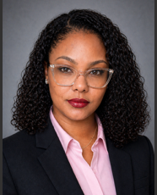
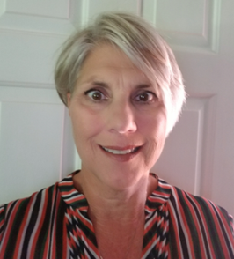



Dorice Firmin
(502)403.9473
Dorice.Firmin@louisvilleky.gov
Serving: Jefferson County
Ginny Whitt
(502)536.0196
Ginny.Whitt@kipda.org
Serving: Bullitt, LaRue, Marion, Nelson and Washington Counties
Jeanna Smith
(502)918.1379
Jeanna.Smith@kipda.org
Serving: Breckinridge, Grayson, Hardin and Meade Counties
Greysun Farmer
(502)693.2198
Greysun.Farmer@kipda.org
Serving: Carroll, Henry, Oldham
and Trimble Counties
Jennifer Mendez
(502)489.4744
Jennifer.Mendez@louisvilleky.gov
Serving: Jefferson County

Slide 3
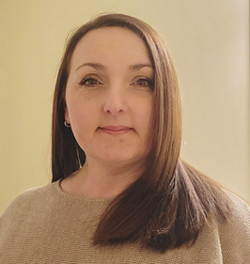
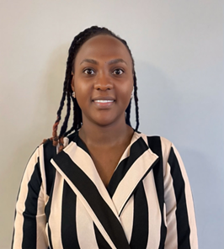
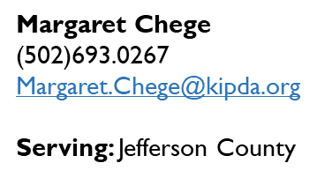



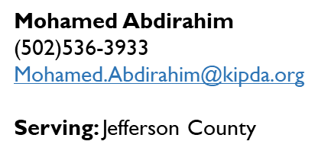
Kerri Sapp
(502)918.0626
Kerri.Sapp@kipda.org
Serving: Bullitt, Oldham, Shelby and Spencer Counties

Slide 4


Medicaid and kynect Health Plan
Income Limit Chart
Household Size | Whole Family Eligible for Medicaid Up To 138% |  | Eligible for QHP with APTC and Cost Sharing Level “94” > 138% - 150% |  | Eligible for QHP with APTC and Cost Sharing Level “87” >150% - 200% |  | Eligible for QHP with APTC and Cost Sharing Level “73” >200% - 250% |  | Eligible for QHP with APTC >250% - 400%
 | 138%* |  | 150%** |  | 200%** |  | 250%** |  | 300%** |  | 400%**
 | Monthly | Yearly | Monthly | Yearly | Monthly | Yearly | Monthly | Yearly | Monthly | Yearly | Monthly | Yearly
1 | 1,836 | 22,032 | 1,957 | 23,490 | 2,610 | 31,320 | 3,262 | 39,150 | 3,915 | 46,980 | 5,220 | 62,640
2 | 2,489 | 29,868 | 2,644 | 31,734 | 3,526 | 42,312 | 4,408 | 52,890 | 5,289 | 63,468 | 7,052 | 84,624
3 | 3,142 | 37,704 | 3,331 | 39,978 | 4,442 | 53,304 | 5,553 | 66,630 | 6,663 | 79,956 | 8,884 | 106,608
4 | 3,795 | 45,540 | 4,020 | 48,240 | 5,360 | 64,320 | 6,700 | 80,400 | 8,040 | 96,480 | 10,720 | 128,640
5 | 4,449 | 53,388 | 4,707 | 56,484 | 6,276 | 75,130 | 7,845 | 94,140 | 9,414 | 112,968 | 12,552 | 150,624
6 | 5,102 | 61,224 | 5,394 | 64,728 | 7,192 | 86,304 | 8,990 | 107,880 | 10,788 | 129,456 | 14,384 | 172,608
7 | 5,755 | 69,060 | 6,082 | 72,990 | 8,110 | 97,320 | 10,138 | 121,650 | 12,165 | 145,980 | 16,220 | 194,640
8 | 6,408 | 79,896 | 6,769 | 81,234 | 9,026 | 108,312 | 11,283 | 135,390 | 13,539 | 162,468 | 18,052 | 216,624
9 | 7,062 | 84,744 | 7,458 | 89,496 | 9,944 | 119,328 | 12,430 | 149,160 | 14,916 | 178,992 | 19,888 | 238,656
10 | 7,716 | 92,592 | 8,146 | 97,758 | 10,862 | 130,344 | 13,578 | 162,930 | 16,293 | 195,516 | 21,724 | 260,688

